Slide 1
Data Analytics (CMP330)
Dr. David Glass
School of Computing
dh.glass@ulster.ac.uk

Slide 2

Module Coordinator
Dr David Glass
dh.glass@ulster.ac.uk
Room BC-05-130

Slide 3
The Module – Weekly Format
12 weeks of content delivery
Each week:
2 hours lectures
2 hours labs
Attendance is monitored

Slide 4
The Module – Learning Outcomes
At the end of the module, successful students will be able to:
Demonstrate understanding of the concepts of data analytics, data modelling, descriptive and inferential statistics and data governance
Operate in integrated development environments for statistical computing and data analysis as well as demonstrate proficiency in the practical use of statistical programming languages
Apply the data analytics process to real-life datasets to address contemporary data analytics problems faced in real-life scenarios
Prepare and present the results of the application of the data analytics process to real-life scenarios using appropriate tools and techniques.

Slide 5
The Module - Information
2024-25 Handbook & VLE
Module Handbook published in Blackboard
All relevant information for the module including:
Sequence of Teaching
Resources
Assessment
Information on Support (Module and University Level)
Module Area in Blackboard
Assessment and Feedback area for tests and submissions

Slide 6
The Module - Assessment
2024-25 Assessment
Class Test:
Week 7 during the Lab
Two-hour duration (with extra time as required)
Open book
Feedback: As per University Guidance (20 Working Days)
Practical Skills Assessment:
Two weeks to work on the assessment
Finalised during two-hour, open book lab session in week 15 (week beginning 5th May)
Required to modify code to answer questions in Blackboard test and submit your code/results
Feedback: As per Univerisity Guidance (20 Working Days)

Slide 7
The Module - Assessment
2024-25 Assessment
Plagiarism is a serious offence. When submitting your work, you are agreeing to the following statement:
“I declare that this is all my own work. Any material I have referred to has been accurately referenced and any contribution of Artificial Intelligence technology has been fully acknowledged. I have read the University’s policy on academic misconduct and understand the different forms of academic misconduct. If it is shown that material has been falsified, plagiarised, or I have otherwise attempted to obtain an unfair advantage for myself or others, I understand that I may face sanctions in accordance with the policies and procedures of the University. A mark of zero may be awarded and the reason for that mark will be recorded on my file.”

Slide 8
The Module - Assessment
2024-25 Marking Scheme for Practical Skills Assessment (Coursework 2)
Element Being Assessed | Contribution to CW
Exploratory data analysis and data preparation | 20%
Data Analytics Solution Part A: Application of machine learning - feature selection, training and evaluation of model, cross-validation, evaluation metrics Part B: Improving model performance - tuning hyperparameters | 40% 10%
Presentation of Results | 30%

Slide 9
The Module - Assessment
2024-25 Assessment Rubric
Criteria (100%) | 0-39% fail | 40-49% 3rd | 50-59% 2.2 | 60-69% 2.1 | 70-79% 1st | 80-100% High 1st
Exploratory data analysis and data preparation 20% | Very basic EDA and little or no data preparation. | Adequate EDA with some data preparation. | Good EDA with reasonably detailed data preparation. | Very good EDA with thorough data preparation. | Excellent EDA with detailed and thorough data preparation. | Outstanding EDA with extensive and thorough data preparation.
Data Analytics Solution 50% | Very limited solution with very few correct results and little or no evaluation. | Adequate solution with some correct results and basic evaluation. | Good solution with good range of correct results and clear evaluation. | Very good solution with wide range of correct results and thorough evaluation. | Excellent solution with very wide range of correct results and extensive evaluation. | Outstanding solution with excellent range of correct results involving advanced techniques with extensive evaluation.
Presentation of Results 30% | A very poor presentation of results that lacks detail or proper formatting. No references. | An adequate presentation of results but with limited detail or proper formatting. Few if any references. | A good presentation of results with reasonable level of detail and appropriate formatting. Some references included. | A very good presentation of results with appropriate level of detail and good formatting. Some relevant references cited properly. | An excellent presentation of results with high level of detail and excellent formatting. Good use of relevant references cited properly. | An outstanding presentation of results with extensive level of detail and excellent formatting. Excellent use of highly relevant references cited properly.

Slide 10
The Module – Rough Plan
Note: This is subject to change!
Week | Topic
1 | Introduction to Data Analytics and R
2 | Introduction to Programming with R
3 | Descriptive Statistics and Visualisation Using R
4 | Introduction to Normal Distribution and Probability Density Functions Using R
5 | Introduction to Inferential Statistics and Hypothesis Testing with R
6 | Linear and Logistic Regression

Slide 11
The Module – Rough Plan
Note: This is subject to change!
Week | Topic
7 | Feature Engineering and Selection
8 | Data Modelling Techniques: ML Algorithms Part 1
9 | Model Performance Evaluation
10 | Data Modelling Techniques: ML Algorithms Part 2
11 | Data Modelling Techniques: Algorithms Part 3
12 | Improving Model Performance

Slide 12
Week 1 – Introduction to Data Analytics
ulster.ac.uk

Slide 13
Week 1
Content
Introduction to Data Analytics
Introduction to AI and Machine Learning
Introduction to R
Introduction to R Studio
R Basics
– R Vectors

Slide 14
Introduction to Data Analytics
“The global big data analytics market size was valued at USD 307.51 billion in 2023. The market is projected to grow from USD 348.21 billion in 2024 to USD 924.39 billion by 2032, exhibiting a CAGR [compound annual growth rate] of 13.0% during the forecast period.”
Source: https://www.fortunebusinessinsights.com/big-data-analytics-market-106179

Slide 15
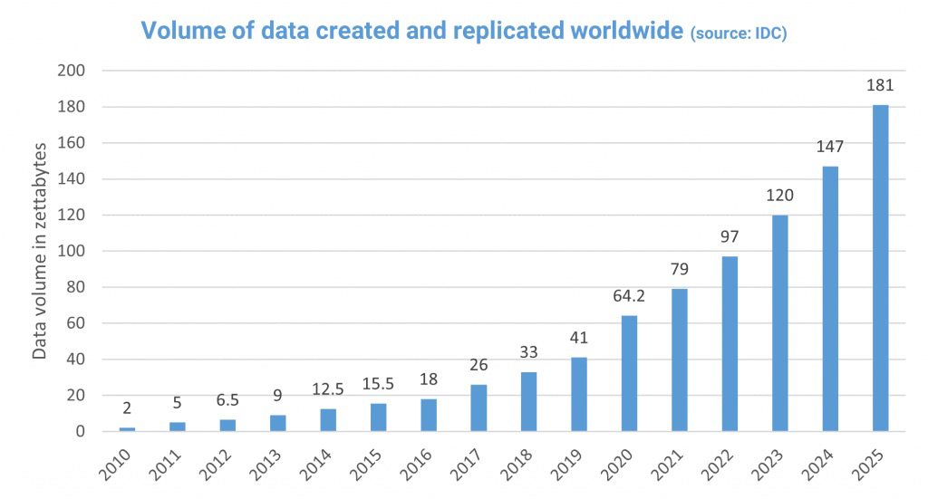

Introduction to Data Analytics
Medical information doubles every 3 years...
Amount of data is growing 40 times faster than the population….
Average hospital generates about 600TB of data
Source: https://www.red-gate.com/blog/database-development/whats-the-real-story-behind-the-explosive-growth-of-data

Slide 16
Introduction to Data Analytics
‘Big Data’
Volume – important, but not the only factor
Velocity – rate at which data is generated
Variety – types of data: structured, unstructured, semi-structured
Veracity – reliability and accuracy of data
Sources: Internet of Things, social media, science, finance
Challenges: Integration, management, analysis (traditional approaches too limited)

Slide 17
Introduction to Data Analytics
A New Paradigm for Science:
Conventional scientists
Prospective studies with a single hypothesis
Big data scientists
Retrospective data mining
Looking for patterns without a particular hunch

Slide 18
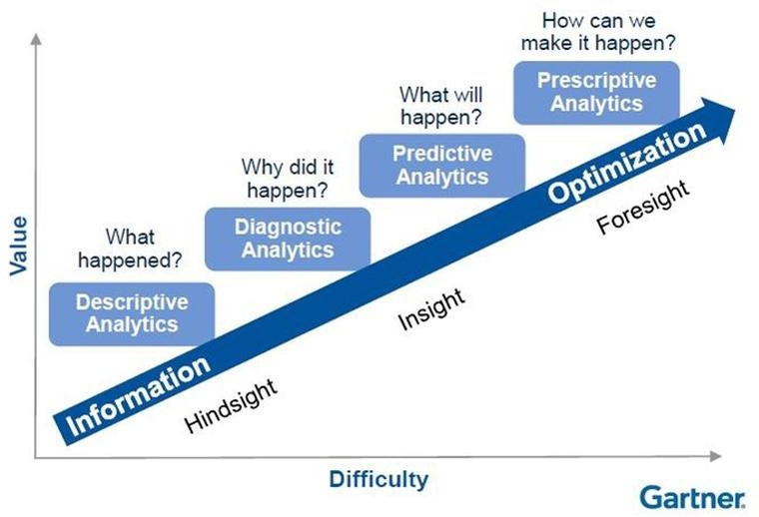
Introduction to Data Analytics
Types of Analytics
Gartner Analytic Continuum
https://www.argility.com/argility-ecosystem-solutions/industry-4-0/predictive-prescriptive-analytics/

Slide 19
Introduction to Data Analytics
Data Analytics
Data gathering and data linking
Data cleansing
Exploratory data analysis
Data visualization
Association mining
Unsupervised machine learning
Machine learning
Feature engineering
Model building
Model optimization
Model evaluation

Slide 20
Introduction to Data Analytics
Examples
Business analytics
Risk
Fraud
Health
Web
Spatial data
…

Slide 21
Introduction to Data Analytics
Business Analytics
Amazon
Personalised Recommendations
– based on items viewed, added to cart or purchases
– 35% of sales
Dynamic Pricing
– adjusts prices regularly based on competition and demand

Slide 22
Introduction to Data Analytics
Medical Analytics
Prediction of Disease
identify patterns in data that suggest onset of disease
e.g. digital alert system for signs of sepsis, interventions resulting in 24% reduction in risk of death https://www.mdpi.com/2075-4426/14/2/149
Personalised Medicine
use patient data (clinical, genetic, etc.) to devise unique treatment plans
e.g. personalised treatment of cancer
https://www.cruk.cam.ac.uk/research-themes/personalised-medicine/
25

Slide 23
Introduction to Data Analytics
Big Data Analytics in Fintech
Data analytics can improve the finance in:
Fraud detection
Risk management
Portfolio optimisation
through use of:
Data-mining and data visualisation
Data-driven decision-making and risk analysis
Automation of business processes
https://www.altamira.ai/blog/big-data-analytics-in-fintech/
30

Slide 24
Introduction to Data Analytics
Confused about Nomenclature?
Artificial Intelligence Computational Intelligence Intelligent Systems
Data Analytics Data Mining Data Science Data Wrangling Big Data
Machine Learning Algorithms
Statistical modeling, signal processing, feature engineering, statistical computing, statistical learning, pattern recognition,
computer vision…
31

Slide 25
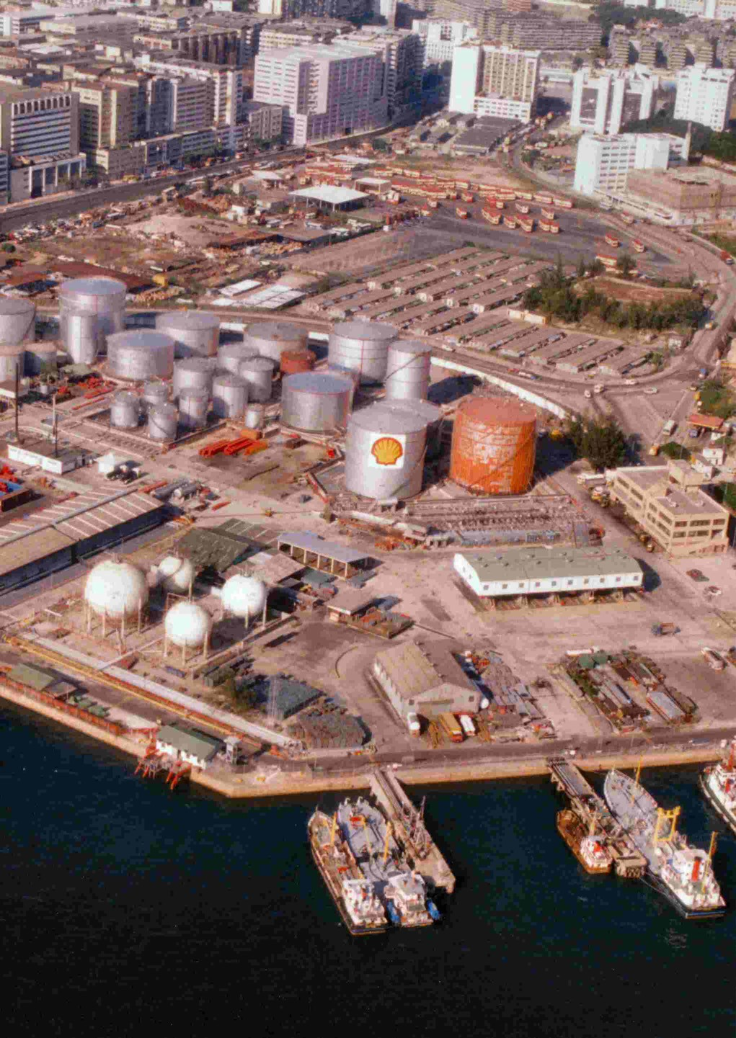
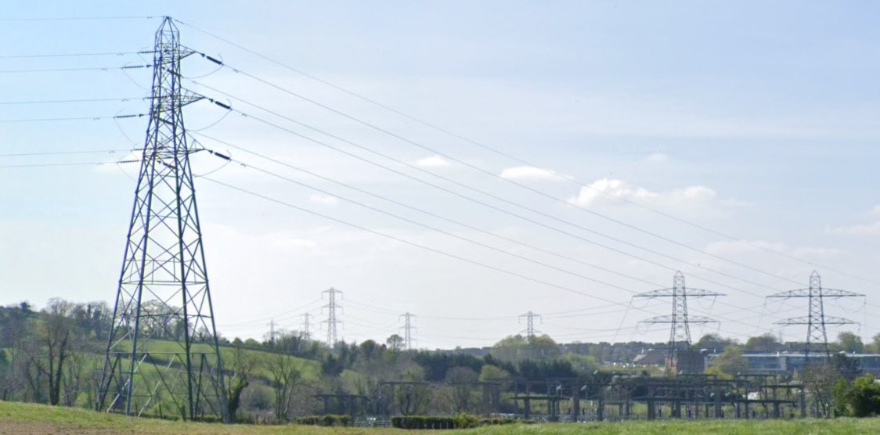
Introduction to AI
The Recent Rise of AI
“AI is the new electricity. Just as 100 years ago electricity transformed industry after industry, AI will now do the same.”
- Andrew Ng
AI is the new electricity!
Data is the new Oil… or is it?
By Paddy Briggs at English Wikipedia - Transferred from en.wikipedia to Commons., Public Domain, https://commons.wikimedia.org/w/index.php?curid=1937488
32
Source: Google map street view

Slide 26
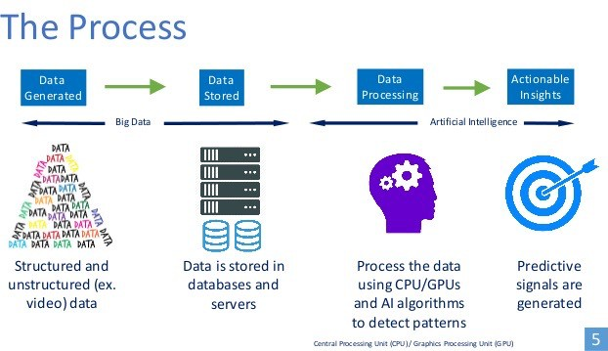
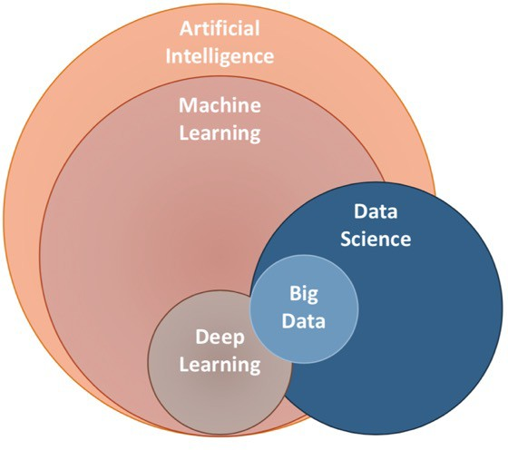
Introduction to AI
The Recent Rise of AI
Source: https://devopedia.org/artificial-intelligence
Source: https://ai.plainenglish.io/data-science-vs-artificial- intelligence-vs-machine-learning-vs-deep-learning-50d3718d51e5

Slide 27
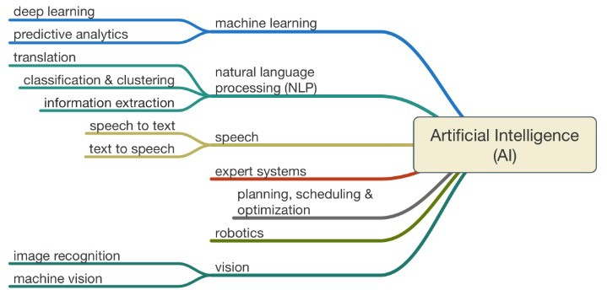
Introduction to AI
AI Categories
https://www.codeproject.com/Articles/1182210/Artificial-Intelligence

Slide 28
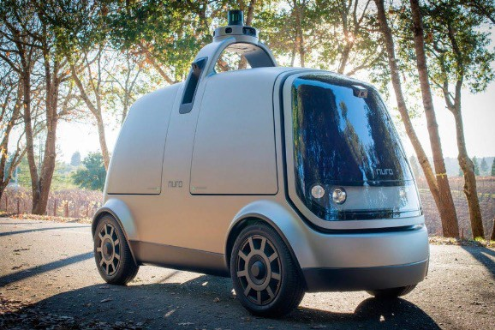
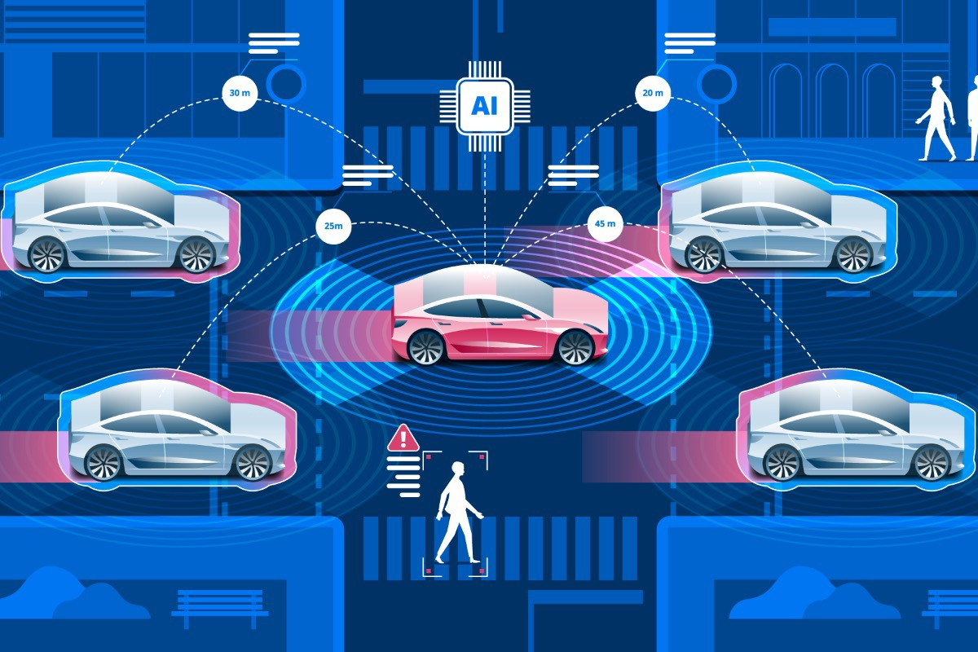

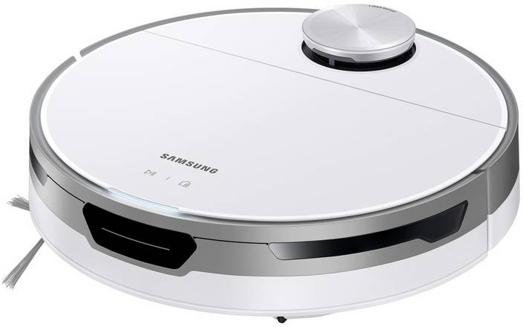

Introduction to AI
AI Examples
Autonomous Driving
Computer Vision
Speech and Language Processing Technologies
Robotics
Games
Decision Making

Slide 29
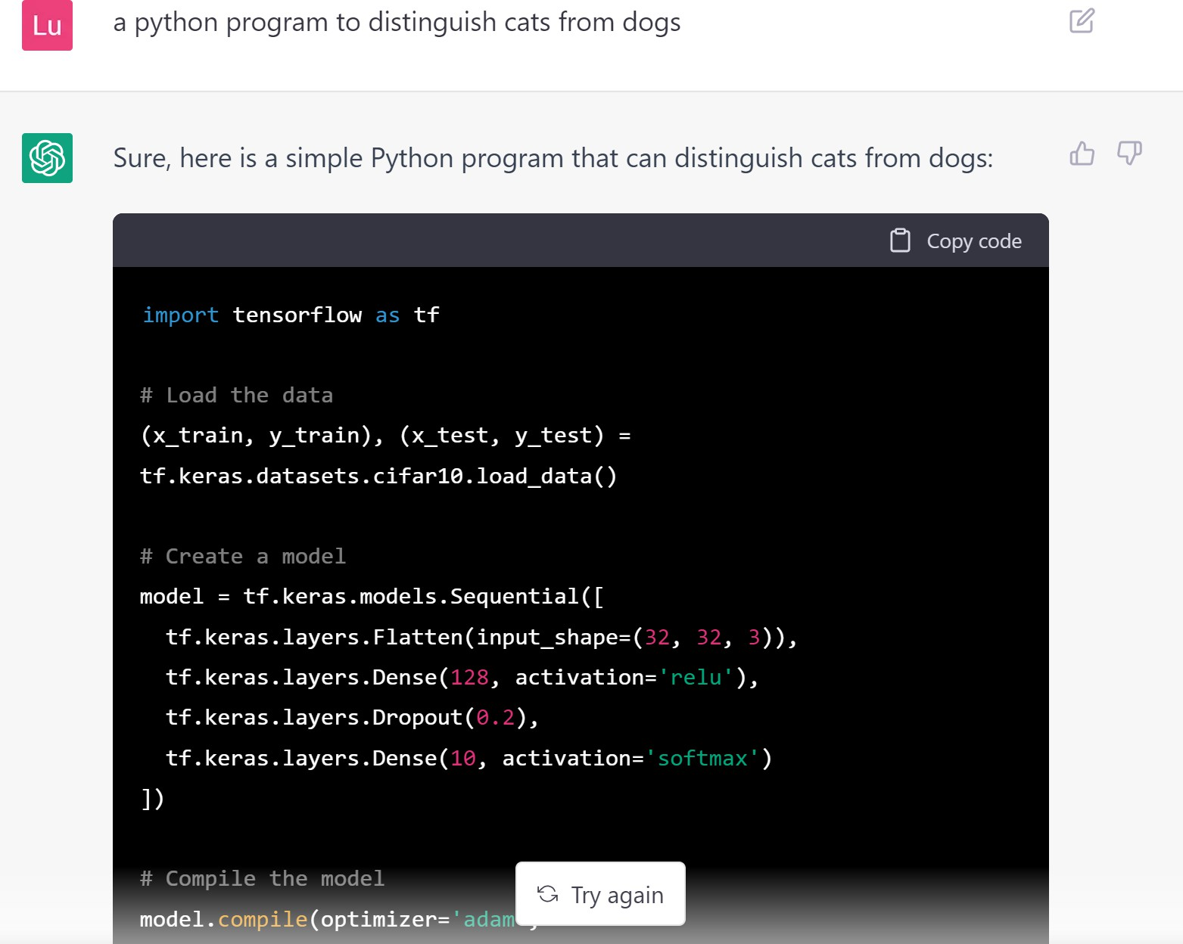

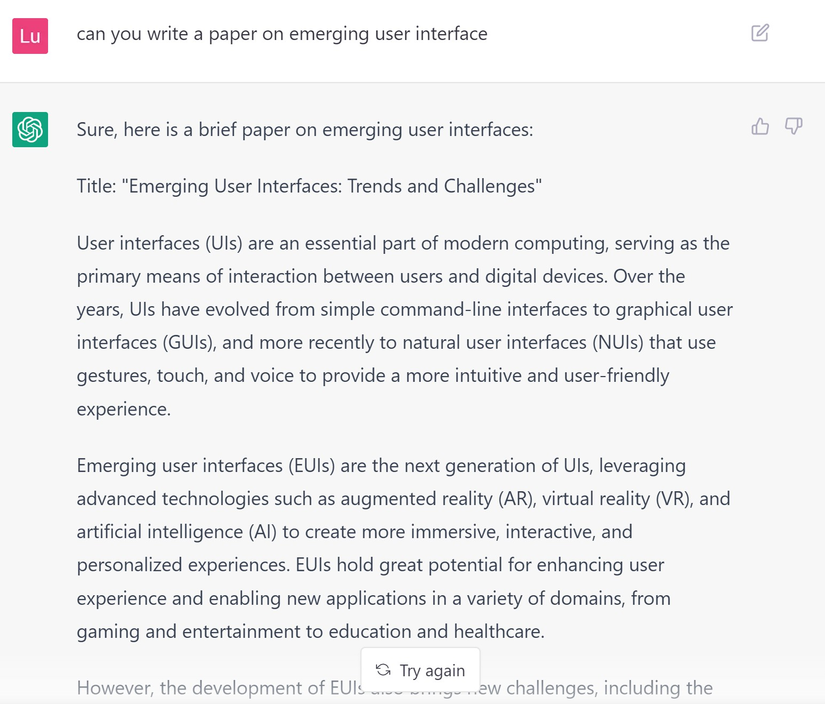
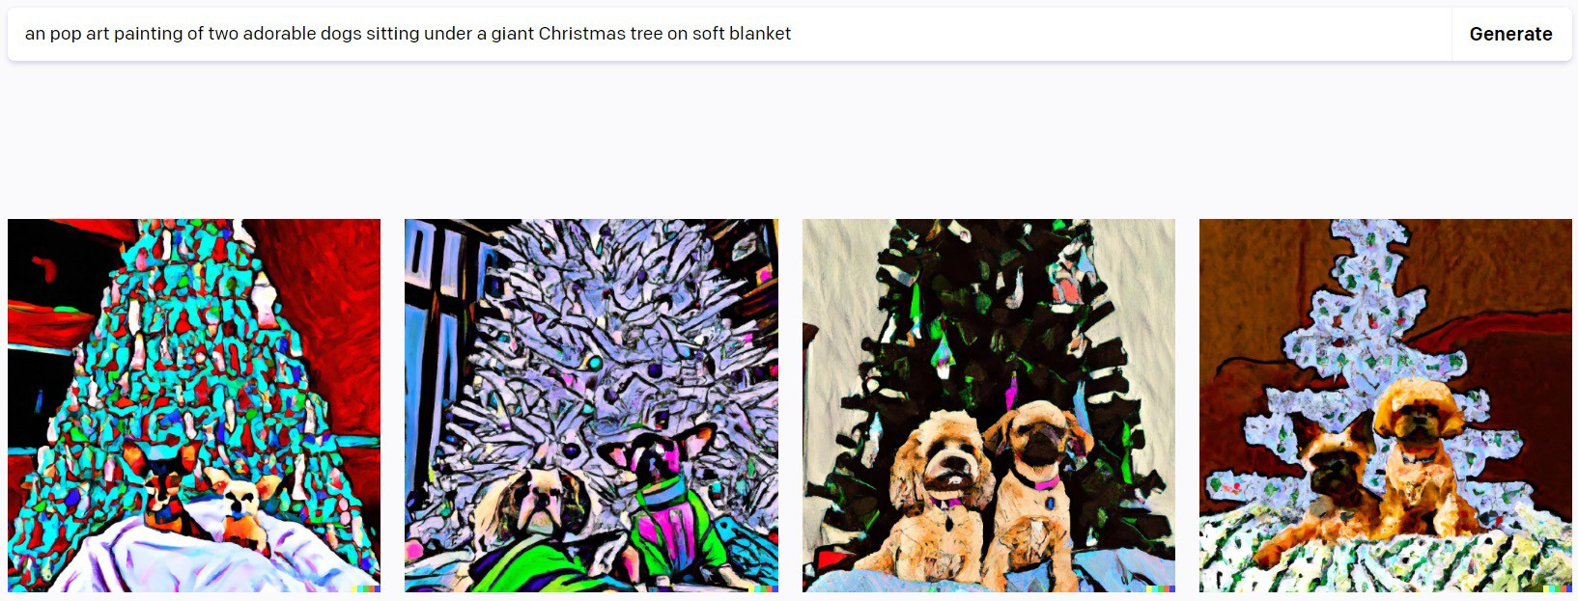
Introduction to AI
AI Examples
ChatGPT
AI generated Art
From text to Images

Slide 30

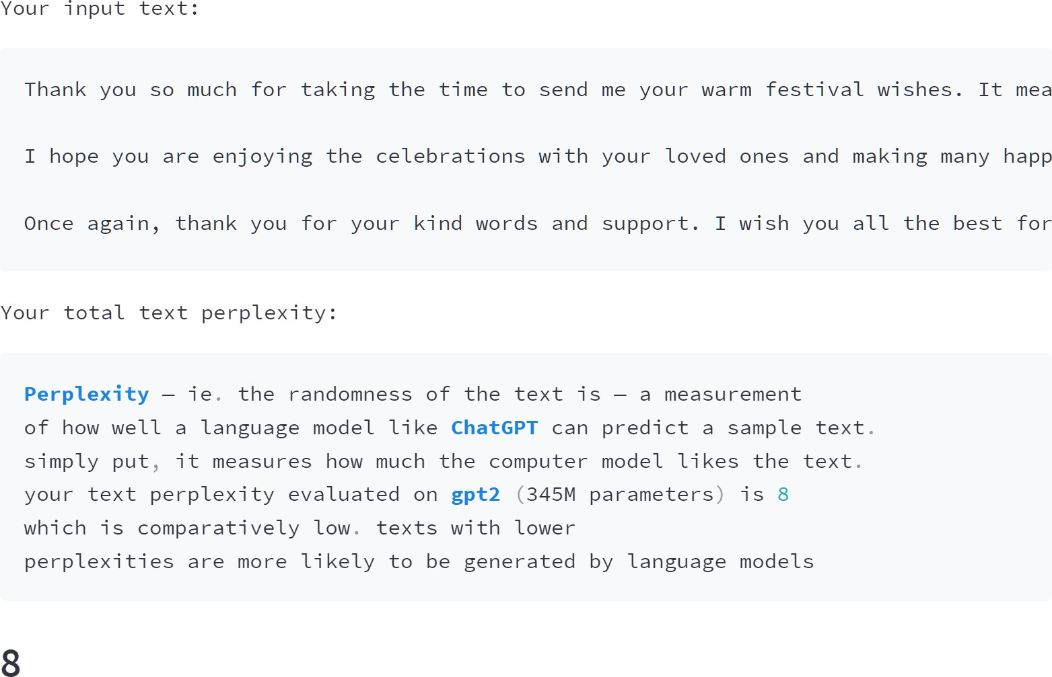
Introduction to AI
AI Examples
GPTZero

Slide 31
Introduction to Machine Learning
Machine Learning
Can machines learn?
By experience vs. by thinking
Are they intelligent?
Bees, Humans and SatNavs…
“There's a great phrase, written in the '70s: 'The definition of today's
AI is
a machine that can make a perfect chess move while the room is on fire
.”
- Fei-Fei Li

Slide 32
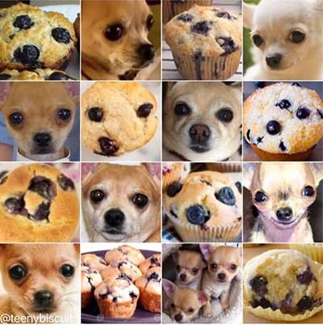
Introduction to Machine Learning
Machine Learning
Humans vs. Machines
Depends what you compare.
If it takes a person 1.5 minutes to
complete a CPU instruction using pen and paper,
then a CPU on
a smart phone could compute
these instructions 70 times faster than the entire
world population.
Then again, we have
100 trillion
connections between neurons
and we can identify
Chihuahuas from muffins …
Munroe, R., 2014. What If?: Serious Scientific Answers to Absurd Hypothetical Questions. Hachette UK.
http://interactionstation.wdka.hro.nl/mediawiki/images/a/a7/Chihuahua.jpeg

Slide 33
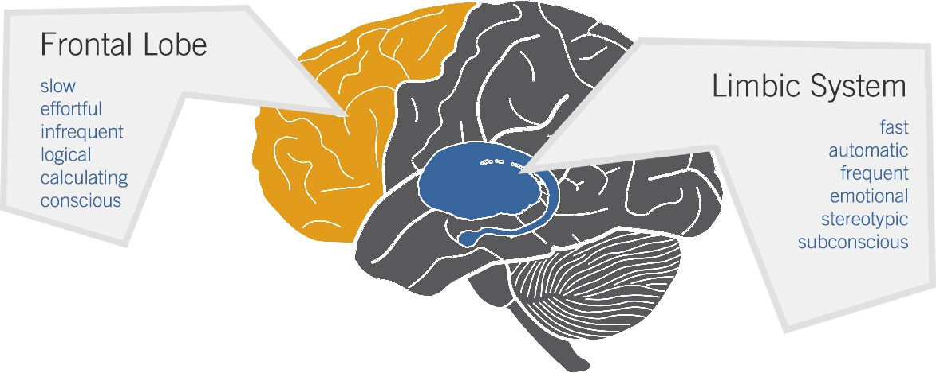
Introduction to Machine Learning How Humans Think- Dual Process Theory of Cognition
System 1: Effortless automatic and fast thinking, intuition – Easy for humans, difficult for computers
System 2: Tiring slow thinking, calculated – Difficult for humans, easy for computers

Slide 34
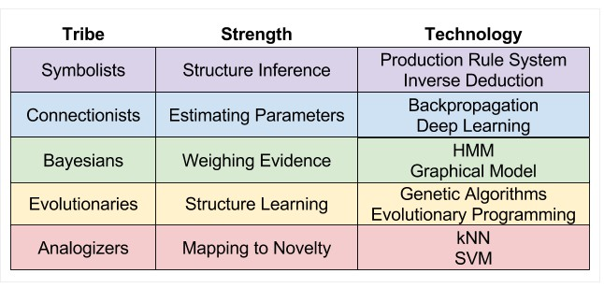
Introduction to Machine Learning 5 Tribes of ML & the No Free Lunch Theorem

Slide 35
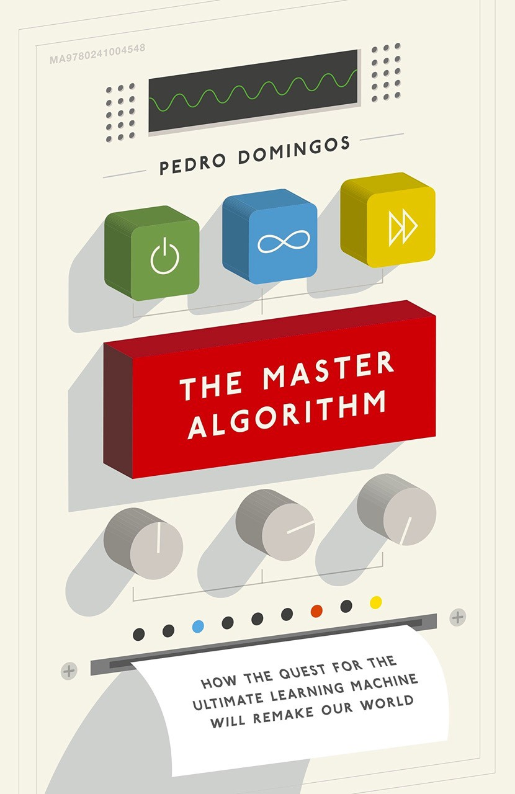
Introduction to Machine Learning
The Master Algorithm
The Master Algorithm – could there be a unified theory of machine learning or AI?
Or do we accept the
No Free
Lunch Theorem?

Slide 36
Introduction to Machine Learning
The Master Algorithm
“If you’re a lazy and not-too-bright computer scientist, machine learning is the ideal occupation, because learning algorithms do all the work but let you take all the credit.”
Pedro Domingos, The Master Algorithm: How the Quest for the Ultimate Learning Machine Will Remake Our World
If ML were a product in a supermarket, the instructions would be just add data …

Slide 37
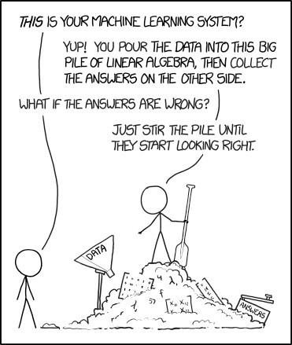
Introduction to Machine Learning
The Master Algorithm
The Neat and the Scruffy Data Scientists
Kolodner, J.L., 2002. The" neat" and the" scruffy" in promoting learning from analogy: We need to pay attention to both. The Journal of the learning Sciences, 11(1), pp.139-152.
44

Slide 38
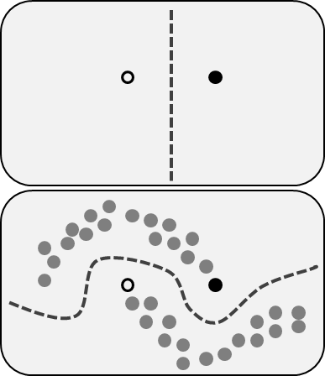
Introduction to Machine Learning
Machine Learning
Supervised ML
Labelled data
SVM, Logit, Decision trees, K-NN…
Unsupervised ML
Unlabelled data
Clustering, Association rule mining
Semi-supervised ML
Some labelled data

Slide 39
Data Analytics Technologies
A Very Brief Overview
Wide variety of different languages and tools.
Here is a very incomplete overview.
Category | Technology
Programming Langauges | Python, R, Julia, Java, Scala
Statistical Analysis Tools | SPSS, SAS, MATLAB, R
Data Query and Storage | SQL, NoSQL databases, Cloud warehouses
Machine Learning and Data Science Platforms | RapidMiner, WEKA, SAS, MATLAB, TensorFlow, PyTorch
Big Data Tools | Hadoop, Spark, Kafka
Cloud Analytics Platforms | AWS, Google Cloud, Microsoft Azure

Slide 40
Further Reading
Is a master algorithm the solution to our machine learning problems?
https://techcrunch.com/2017/01/30/is-a-master-algorithm-the-solution-to-our-machine-learning-problems/
No Free Lunch in Data Science
https://www.kdnuggets.com/2019/09/no-free-lunch-data-science.html
Lantz, B., 2019. Machine learning with R: expert techniques for predictive modeling. Packt Publishing Ltd.

